Slide 1
CLO REPORTING – 16TH EPISCOPAL DISTRICT
“Time to clean out and spiritually restructure our Christian mindsets so as to enhance the morals and values in our temples and homes under this New Normal Umbrella!” PRESENTED BY: THE 16TH LAY EXECUTIVE

Slide 2
THE FOLLOWING MUST BE ADDRESSED
The 16th Episcopal District comprise the largest, geographic and diverse district in African Methodism. There are 7 Conferences-Haiti, Dominican Republic, which includes Brazil, Windward Islands, (T&T/Grenada & Barbados), Guyana/Suriname, V.I (St. Croix, St. Thomas, mission in Belize), Europe (England, France) and Jamaica.
Our District, under the auspices of our Bishop Dr. Marvin C. Zanders II and Supervisor Winifred Houston Zanders, joined in solidarity with all our AME families across the diaspora and we are in constant prayer for the healing of our AME Families in Haiti who have been experiencing severe social, economic and political unrest as well as the Conferences who have experienced severe climatic changes causing earthquakes, thunderstorms and floodings.
We commend CLO President Abe Makiti and his executive for their astute guidance and leadership strategies.

Slide 3
MEMBERSHIP
NAME OF LAY CONFERENCE ORGS/CHURCHES NO. OF MEMBERS
DOMINICAN REPUBLIC (1in Brazil) 14 615
VIRGIN ISLANDS 2 101
JAMAICA 1 33
HAITI
EUROPE
GUYANA/SURINAME 12 155
WINDWARD ISLANDS 13 162
TOTAL 44 1,066

Slide 4
TRAINING
Last year, we began training sessions during the heights of the Covid-19 coronavirus, which severely impacted church growth. These included: Mastering Zoom, Evangelism & Financial Management Training which were conducted to assist us in creating a well-informed and spiritually connected service establishment so that the documented 1,066 membership truly understand the role of the AMEC Lay Org in the District. These are all on-going.
The ongoing resuscitation of the Lay orgs with the provision of Lay Leadership opportunities for the Youth Lay and younger ones through the facilitation of training Workshops in Leadership and Discipleship. Some members continue to attend virtual Theology classes hosted by their Clergy. The attendance and participation of the Young Adults have begun to increase. We now have approximately 30% of the total Lay Org representing Young Adults.

Slide 5
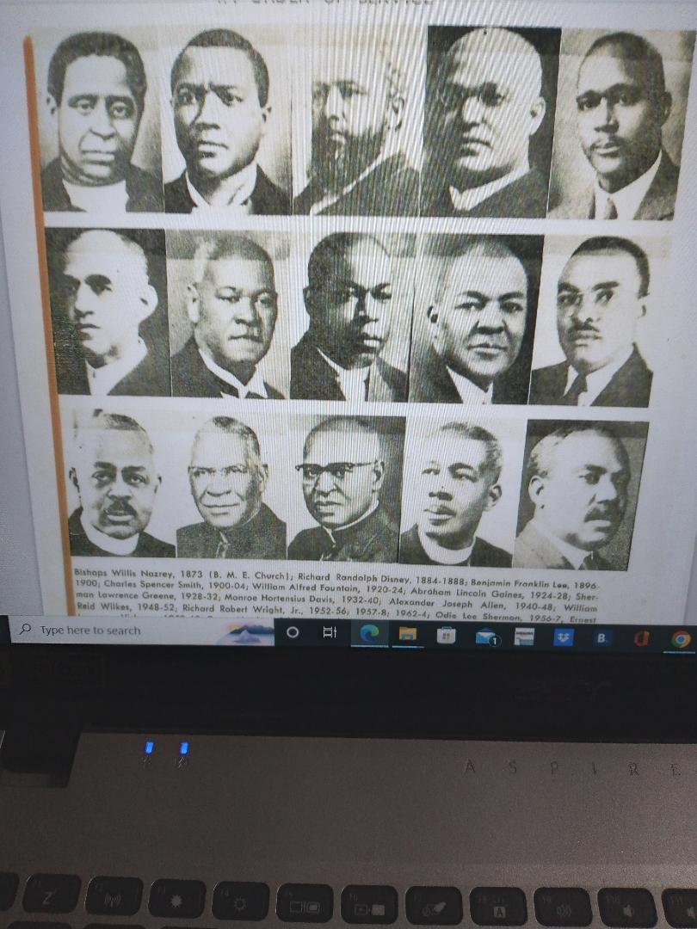
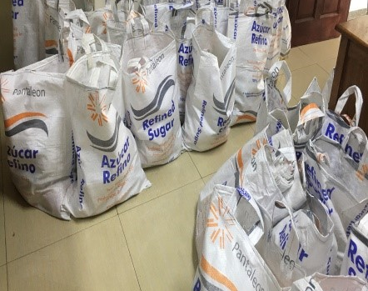
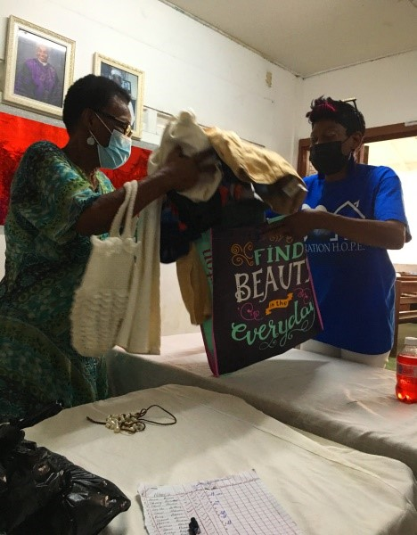
ACCOMPLISHMENTS
Collaborated with the Conference Presidents and established a 2021-2023 Strategic Action Plan.
Hosted for the first time a celebration of the history of the first AME churches in each conference. Phase 1-Bishops who served from 1873 to 1964.
Producing a 16th District Tourism Virtual Drive-Introducing the 16th to the World-Come & Enjoy our Diversity!
“THE JOURNEY NOW START!”
Community Outreach Programs have been on heavy rotation with members assisting with hamper distributions (clothing, foodstuff, toiletries, school supplies) to earthquake & flooding victims. More than 1,000 hampers have been distributed quarterly.

Slide 6
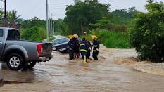
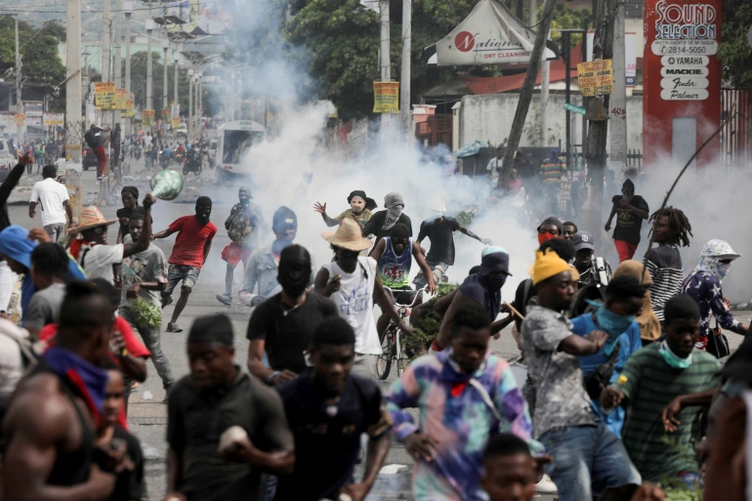
CHALLENGES
Communication Challenges: Language Barriers/ Limited Interpretors
Political, Economic & Social Unrests/Climatic Changes

Slide 7
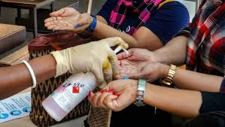
CHALLENGES – HOW CAN WE HELP
RECOMMENDATIONS
Ωε μυστ χοντινυε το σηαρε ινφορματιον αβουτ τηε χυλτυρεσ οφ ουρ Διστριχτσ 1−20 σο ασ το create stronger organizations with the key focus of advancing the total program of the AME Churches globally.
Our Public Relations/Marketing Teams must continue to sensitize the communities about our AME Churches and subsequently the important role played by the church in the reduction of negative isms.
This requires more collaboration and it is vitally important that the Laity play a pivotal role
effectuating this change.
• The Lay Executive (from which all Boards are established) must play an integral role in the
decision making process of the church, thus helping to bridge the gap between Clergy and
Laity.
• More Fundraisers must be hosted so as to be able to assist with accumulating the Budget as
well as more hosting of Evangelism sessions throughout the communities.
• Ongoing education of the Lay Constitution, AME Doctrine & Discipline to the Laity.

Slide 8
UPCOMING EVENTS
WAY FORWARD Still in the process of adjustments, we aim to create a well-informed and connected spiritual service establishment in which all levels of the Laity understand the role of the AMEC in the socio-economic, spiritual development of the district.
The 16th District Lay Convention, in January 2023, which is geared toward:
Enhancing Institutional Strengthening
Communications & Public Relations; Encouraging Capacity Building as well as
Research Development & Innovative Mechanisms to drive revenue generation, church growth & development.

