Slide 1
CLO REPORTING EPISCOPAL DISTRICT PRESIDENTS
DR. Rodrick Moore, President
10th episcopal District

Slide 2
THE FOLLOWING MUST BE ADDRESSED
Membership including Young adults – growth or lack thereof.
Young adult participation
Training – how many training programs have you embarked on as a district?
The 10th District Lay Organization will complete 3 virtual training, a leadership development workshop and training at the State Lay Convention.
Stakeholders engagement
Accomplishments
Challenges
how can we help with regards to your challenges.
Upcoming events
We will continue with our Virtual Training series, leadership development and the State Lay Convention.

Slide 3
MEMBERSHIP
Number of active Lay Organization members in your district.
NW – 45
NT- 151
SW- 128
TX- 402
Total - 726 *please note that these are estimates as we are working to get accurate membership data
Number of Young adults who are members of the Lay Organization in your district.
33

Slide 4
TRAINING
 | Objective | Training Objective | Associated Activity
January 2022 | Leadership workshop | Leadership Development
April 21, 2022 | H. To promote the spread of personal evangelism. | Creating an Evangelistic Atmosphere | Encourage laity to participate in evangelist efforts.
June 16, 2022 | J. To increase the circulation of church periodicals. | Discussion of the various church publications and how to submit articles. | Subscription drive. Submission of articles.
August 2022 | State Lay Convention: Who Will Take Care of You Communicating through the Quarterly Conference Let’s Write a Bill | Self Care and learning to say no. Understanding the need to communicate How to write legislation
December 15, 2022 | I. To provide training in Christian stewardship. | Understanding the finances of various levels of the church. | Being able to read and understand various financial reports. Use the report to inform decisions affecting the church.
What training programes have you embarked on as a district

Slide 5
ACCOMPLISHMENTS
Hosted our first hybrid lay meeting in February 2022
Hosted our first hybrid State Lay Convention in August 2022
Selected our 10th District Lay Person of the Year for 2022
Supported Water Project for Jackson, MS
Participated in all Annual Conference Lay Witness Services
Hosted our first District-Wide hybrid Lay Witness Service
Named/Appointed first young adult as Chair, Social Action Committee
Participated in Black Voters Matter Get Out the Vote Campaign

Slide 6
CHALLENGES
Developing committed, consistent members
Participation at each level (local, PE Districts, Conference, District, Connection)
Growing organizations at the local level
Developing leaders at each level

Slide 7
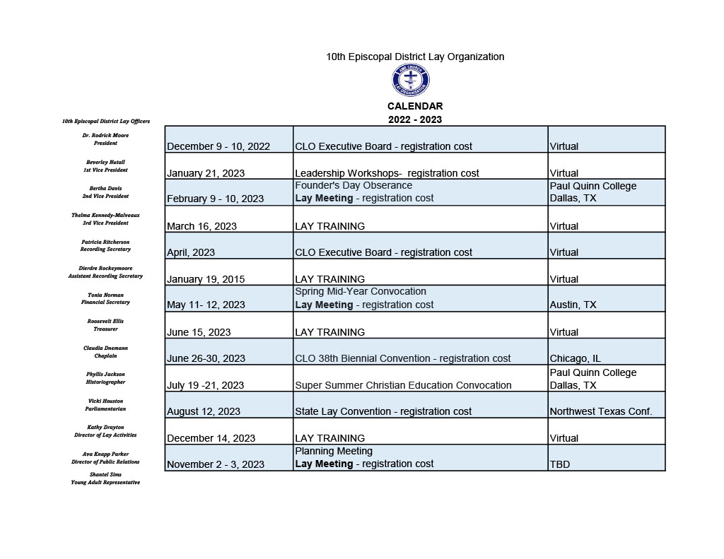
DISTRICT CALENDAR

Slide 8
UPCOMING EVENTS
 | Goal and Objective | Training Objective | Associated Activity
January 21, 2023 |  | Leadership Development | Leadership workshop.
March 16, 2023 | K. To provide for the orderly and systematic training of lay persons, especially officers, in order that they might more effectively perform their service responsibilities. | Keeping Church Property Ownership Safe and Secure. Knowing the Souls in your Church. Understanding the roles of Trustees and Stewards. | Encourage members to be more vocal in the administration of their churches.
April 20, 2023 | E. To foster a systematic and regular study of The Book of Discipline of the African Methodist Episcopal Church and parliamentary procedures. | The Agenda, the Meeting, the Minutes. Creating a more effective organization. | More effective, efficient meetings.
June 15, 2023 | G. To encourage development, recognition, and utilization of the most appropriate operational practices and modern technology. | Put that Pen and Pencil Down! Accounting systems Membership databases Social Media Strategy Website use. | Move our local organizations and assist our churches to move to a comfortable level using technology.
August 12, 2023 |  | (In-person or hybrid?) | State Lay Convention (NWT host)
December 21, 2023 | I. To provide training in Christian stewardship. | To Tithe or Not to Tithe, that is not the Question. | Members will positively impact the church in time, talent, trust, and treasury.

